Slide 1

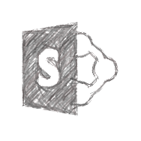






Microsoft365 SharePoint Office 365 SPFX Fabric-UI PnP Azure
Microsoft Build
Introducing Azure Artifacts
Shantha Kumar
Ktskumar
C# Corner MVP

Slide 2
Microsoft365 SharePoint Office 365 SPFX Fabric-UI PnP Azure
AGENDA
Open Source Component
Flexible
Very easy to use
Introduction to Azure DevOps & Azure Artifacts
What’s new at Build 2019
Demo: Azure Artifacts Feed
Demo: Azure Artifacts and upstream sources
Q & A

Slide 3

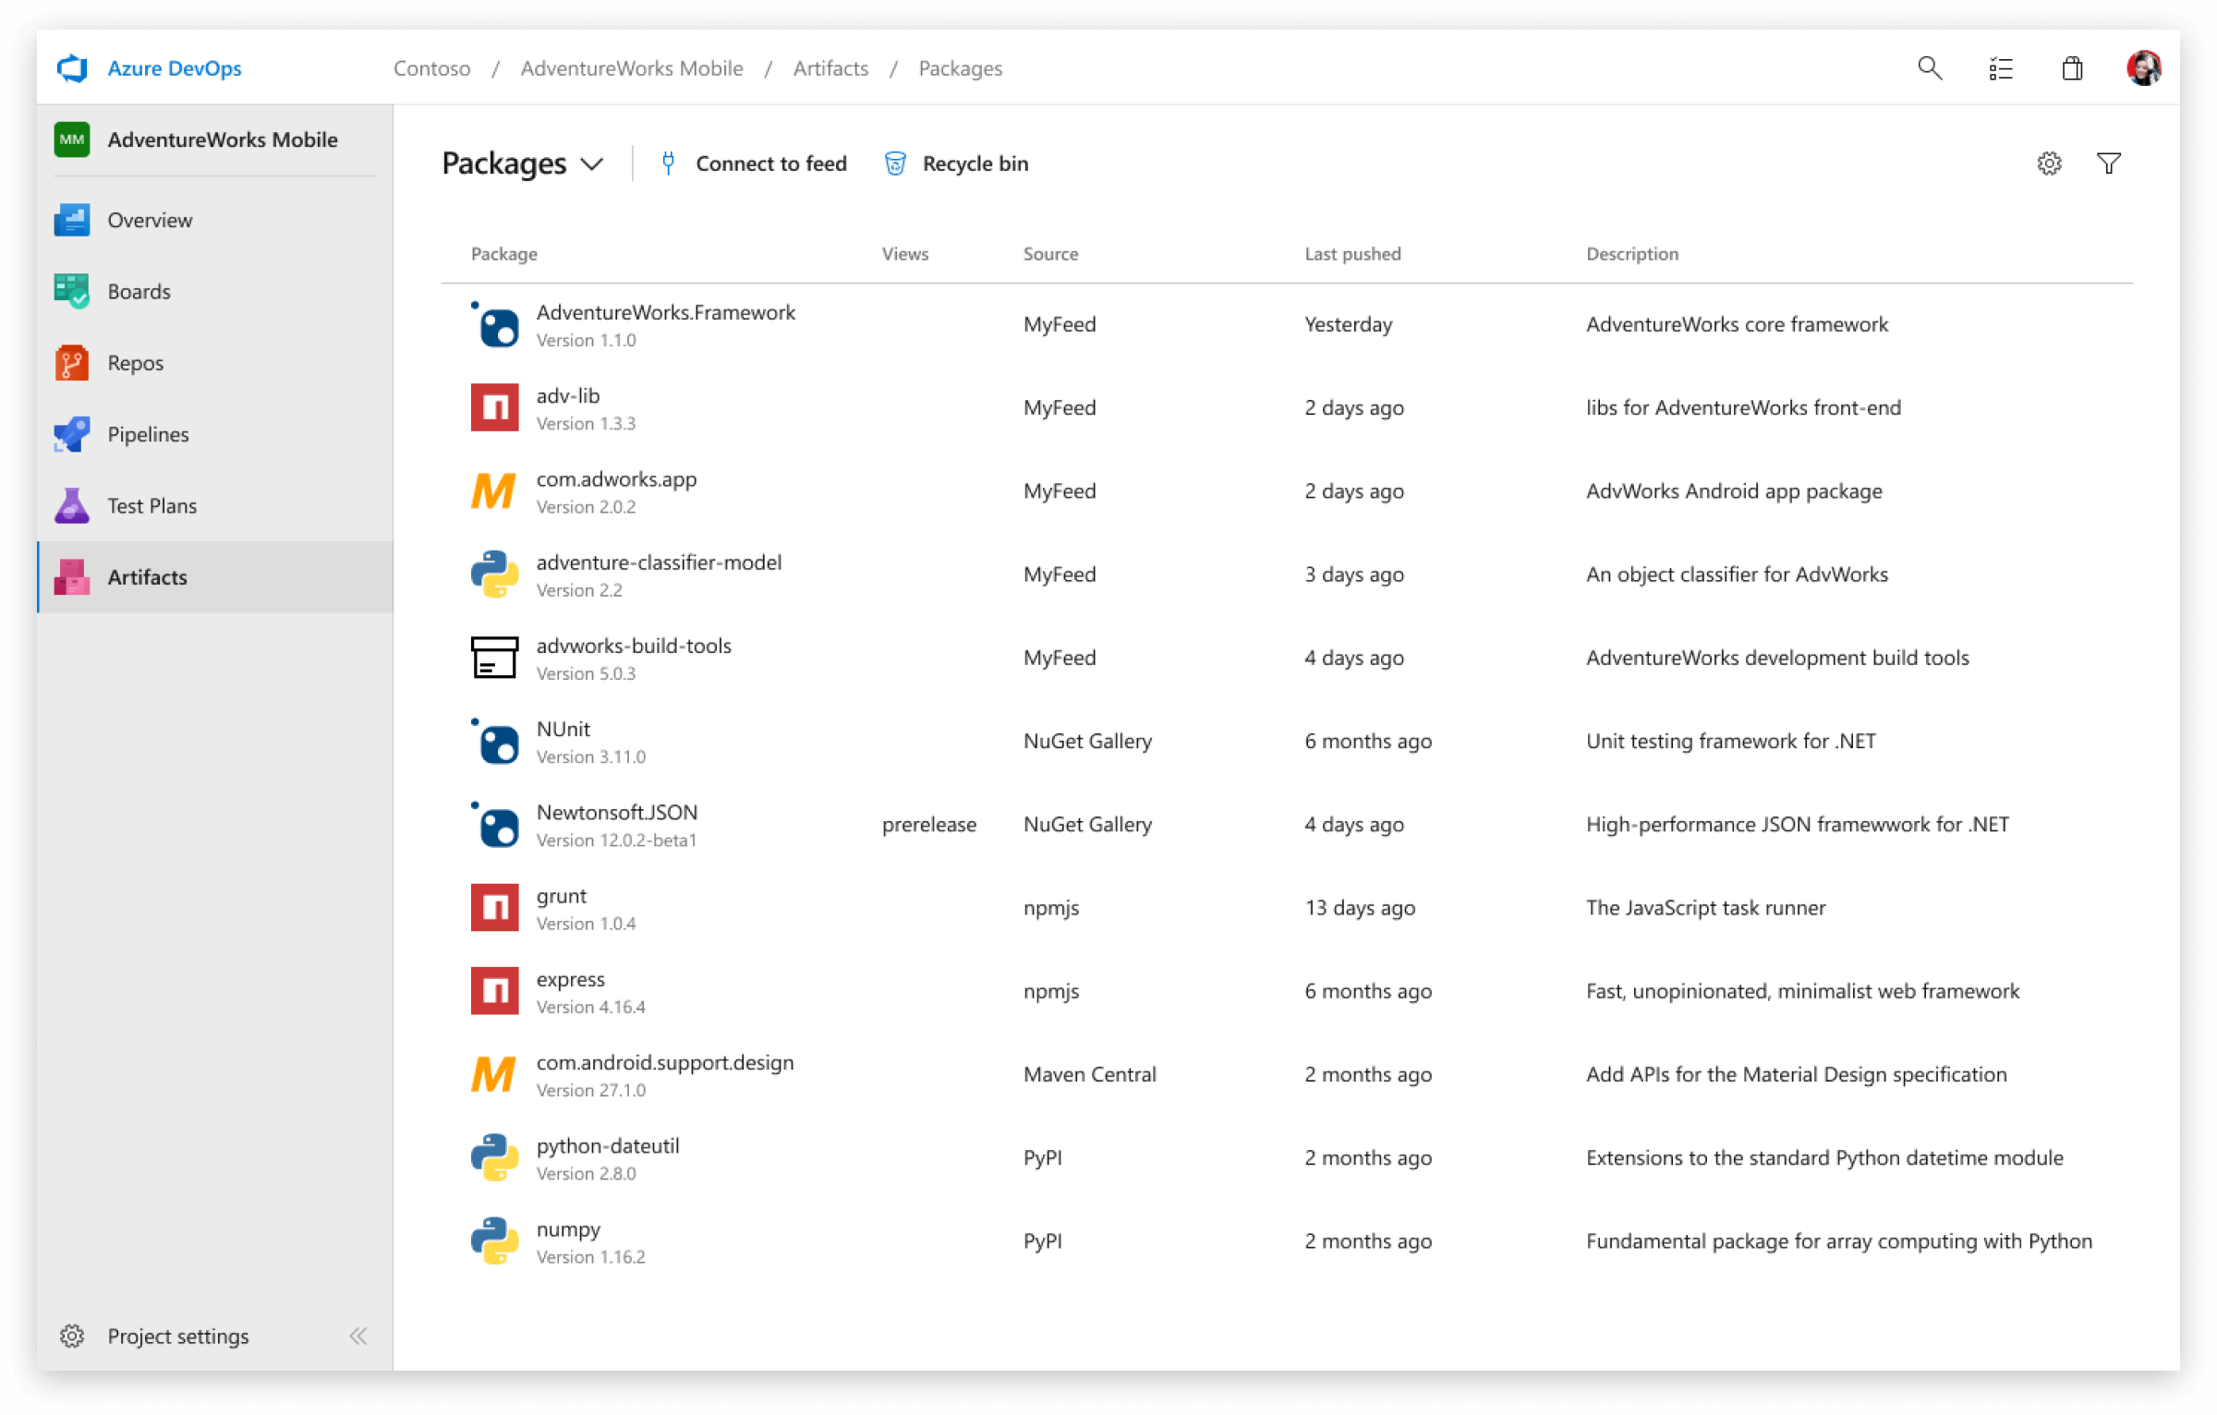




Microsoft365 SharePoint Office 365 SPFX Fabric-UI PnP Azure
AZURE DEVOPS
Azure Pipelines
Open Source Component
Flexible
Very easy to use
Azure Boards
Azure Pipelines
Azure Repos
Azure Test Plans
Azure Artifacts

Slide 4



Microsoft365 SharePoint Office 365 SPFX Fabric-UI PnP Azure
AZURE ARTIFACTS
Keep all your software development artifacts in one place: binaries, packages, tools and more..
Share code efficiently
Easily share code across small teams and large enterprises.
Manage all package types
Get universal artifact management for Maven, npm, NuGet, and Python.
Add packages to any pipeline
Share packages, and use built-in CI/CD, versioning, and testing.
Open Source Component
Flexible
Very easy to use

Slide 5
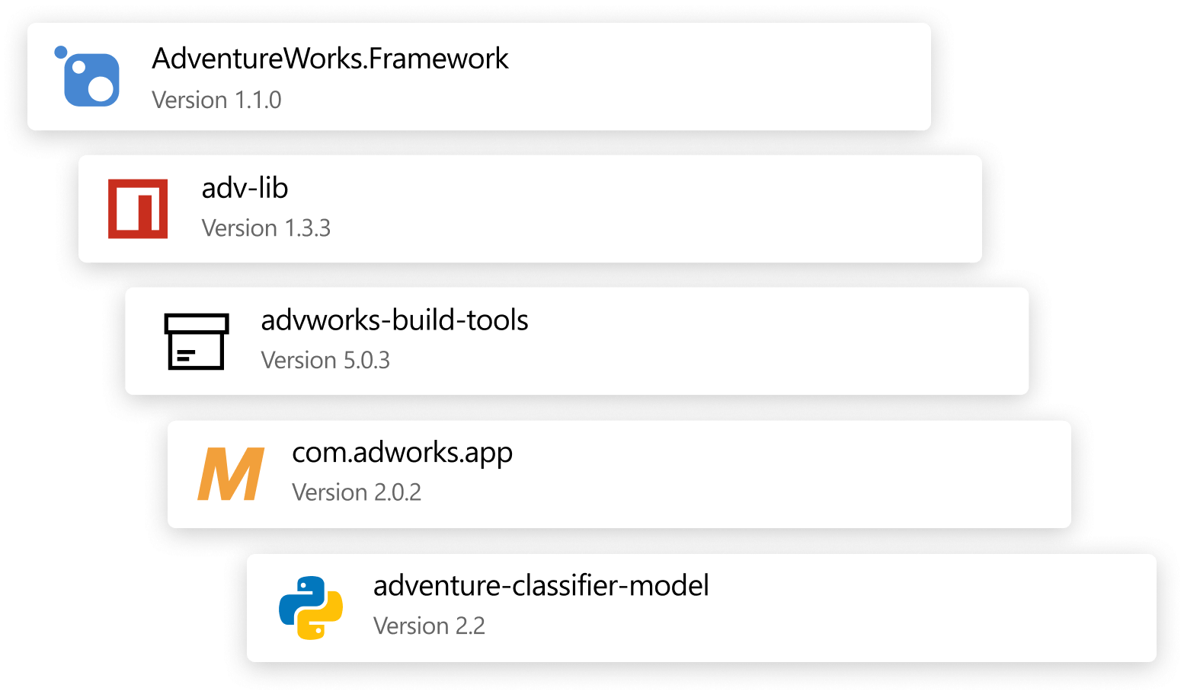
Microsoft365 SharePoint Office 365 SPFX Fabric-UI PnP Azure
KEEP YOUR ARTIFACTS ORGANIZED
Open Source Component
Flexible
Very easy to use
Support for private and public feeds.
Create and share Maven, npm, and NuGet packages
Use Universal Packages to store adhoc binaries to be used in your build and release pipelines – no longer need to store binaries in Git.

Slide 6
Microsoft365 SharePoint Office 365 SPFX Fabric-UI PnP Azure
WHAT’S NEW AT BUILD
Open Source Component
Flexible
Very easy to use
Pay-per-GB pricing launches; user licenses are discontinues
2GB free, tiered after that
Existing organizations get 12 months free
Python and Universal packages are generally available

Slide 7
Microsoft365 SharePoint Office 365 SPFX Fabric-UI PnP Azure
Open Source Component
Flexible
Very easy to use
Demo: Azure Artifacts - Feed

Slide 8
Microsoft365 SharePoint Office 365 SPFX Fabric-UI PnP
Open Source Component
Flexible
Very easy to use
Demo: Azure Artifacts and upstream sources

Slide 9
Microsoft365 SharePoint Office 365 SPFX Fabric-UI PnP
Thank you
Ktskumar.com
Open Source Component
Flexible
Very easy to use
ktskumar
ktskumar
ktskumar
ktskumar
ktskumar

